Slide 1
yes/no questions with “can”
Basic 4 – Unit 12 Lesson B

Slide 2
Can / Can't
“Can” is used to express abilities ☺
If the action is possible you use can.
If the action is not possible you use can’t
For example,
I can speak English and Spanish, but I can’t speak Chinese
My sister can speak Spanish, but she can’t speak English
I can drive a car, but I can’t fly an airplane ☹

Slide 3
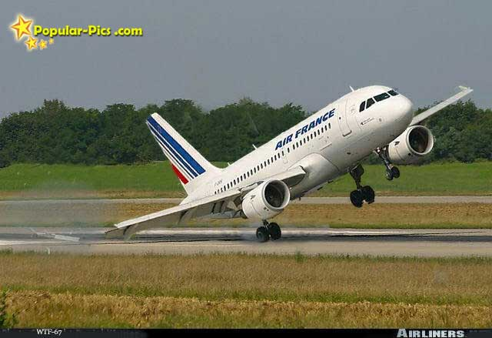
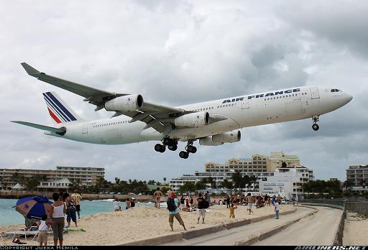
Can airplanes fly ?
Yes, they can.

Slide 4
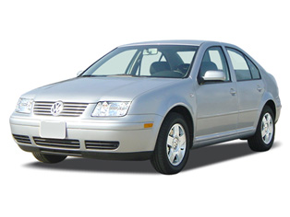
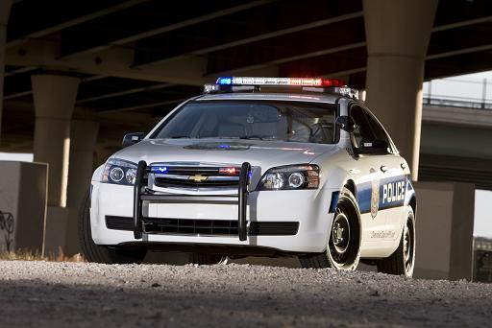
Can cars fly ?
No, they can’t.

Slide 5
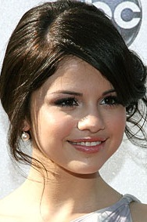

Can they sing?
Yes, they can.

Slide 6
Yes/No questions with “can”
Can
you
drive a car?
Yes,
I can drive a car.
Can
Lola
speak French?
Yes,
Lola can speak French.

Slide 7
Yes/No questions with “can”
Can
you
drive a car?
No,
I can’t drive a car.
Can
they
speak Arabic?
No,
they can’t speak Arabic.

Slide 8
Wh- questions with “can”
What can
you
do?
I can drive a car and fly an airplane
How about you?
What instruments can
you
play?
I can play the piano and the guitar.

Slide 9
Who questions with “can”
Who can
play the guitar?
Carlos can play the guitar.
Who can
sing in English?
I can sing in English

Slide 10
1. ________________________?
Yes, I can. I can draw well.
2. ________________________?
No, I can’t. I’m not creative.
3. ______________________?
Yes, she can. She can sing opera.
4. _____________________?
No, I can’t read Japanese ☹
4. _____________________?
No, I can’t drive a car ☹
6. Can you write poems?
______________________________
7. Can you whistle?
______________________________
8. Can you play the piano well?
__________________________
9. Can you tell interesting stories?
__________________________
10.Can you follow directions on a map?
___________________________

